Slide 1
INTRODUCTION TO Goods and ServiceS Tax ( g s t )
AKHIL V
Assistant Professor
P.G Department of Commerce
N.S.S College Pandalam

Slide 2
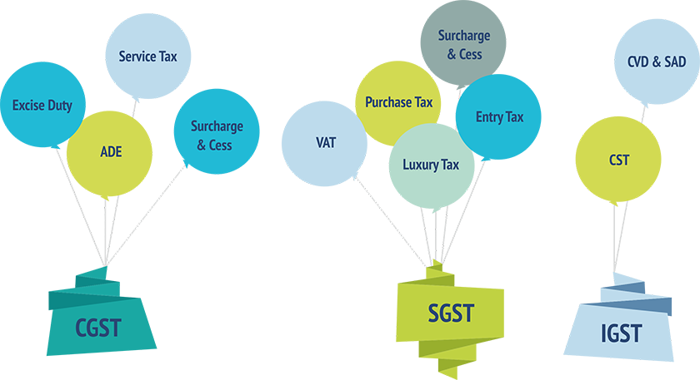

Slide 3
Subsuming of Existing Taxes
CGST
Central Excise
Service Tax
SGST
VAT/sales tax
Lottery Tax
Entry Tax
Purchase Tax
Surcharges and all cesses
IGST
CST
Octroi
Luxury Tax
Additional duties of Custom (CVD)/(SAD)

Slide 4
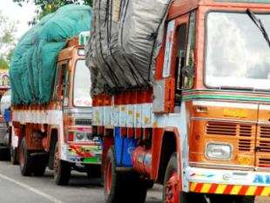
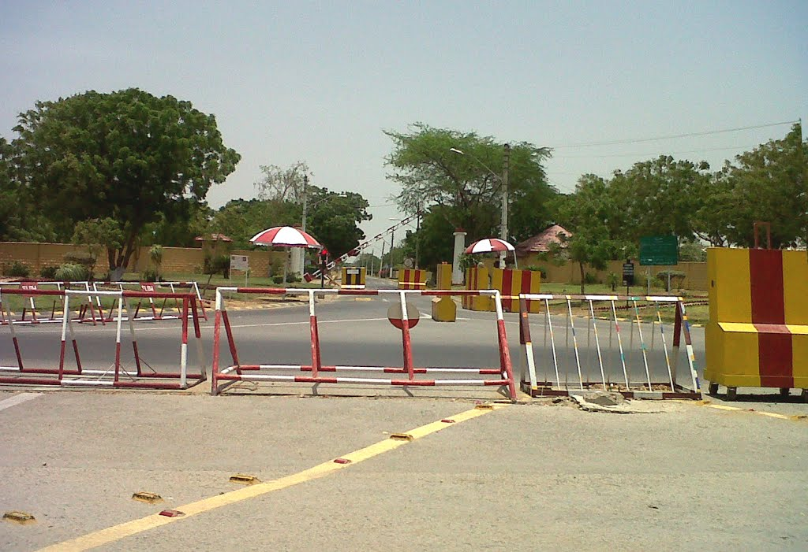
No physical Checkpost but Thermal Checkpost
???????????????????????

Slide 5
Taxes subsumed under GST
Entry Tax, Octroi, LBT
VAT
CVD, SAD
Excise Duty
GST
Surcharges & Cesses
CST
Taxes on lottery, betting & gambling
Entertainment Tax (not by specified bodies)
Luxury Tax
Service Tax

Slide 6
Taxes not subsumed under GST
Stamp Duties,
Taxes on lands and buildings, electricity
GST
Toll tax,
Taxes on carriage by rail/ waterways/ road
Basic Customs Duty,
Export Duties
R&D Cess
Taxes on professions, trade, employments

Slide 7
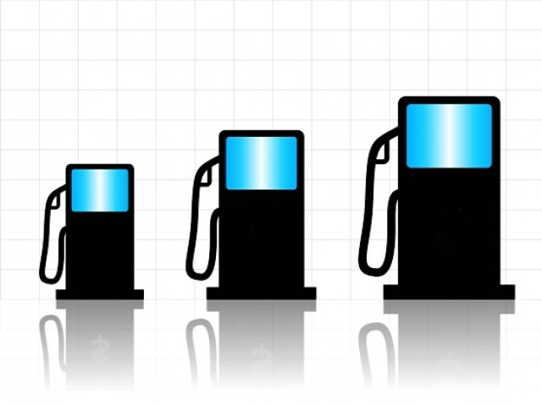
Large part of economy still not covered by GST
5 Petroleum products
Real-estate business
Electricity
Potable Alcohol
5 Petroleum products:
1)Crude oil
2)Natural gas
3)Aviation fuel
4)Diesel
5)Petrol
States are free to levy taxes
No ITC for the above
Hence inflationary tendencies are bound to remain

Slide 8
Basic Structure of GST
Comprehensive value added tax on SUPPLY of goods and services
Consumption based tax … departure from earlier origin based taxation
Model of GST
Intra state supplies
Inter state supplies
CGST
(Centre)
SGST
(State)
IGST
(Integrated)

Slide 9
What will be taxed?
Goods
Services
Imports
Exports
(Except the exclusions)
Movable property
other than money and securities
Anything other than goods
Includes conversion from one currency to another
Exempted with zero rate

Slide 10
GST Rates
Zero rated
28% + add cess
5%
12%
18%
28%
Essential items including food
Mass consumption goods
Standard Rates on all goods
Goods currently taxed at
30-31%
Demerit goods
Tobacco, aerated drinks, pan masala, luxury car
Services might be taxed under 3 rate structure – luxury, basic and standard

Slide 11
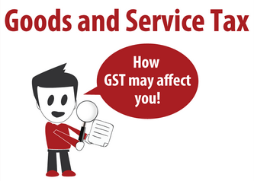

Slide 12
Implementation will involve
Many hiccups
Many delays
Many Computer glitches
Chance of Classification disputes
Chance of Interstate Disputes
Higher rates encourage tax evasion
Channels resources into tax evasion
Notes:
NEGATIVES

Slide 14
Supplies:
Outward Supplies : Sales
Inward Supplies : Purchase
Business Area:
NBTA : Normal Business Tariff Area
SEZ : Special Economic Zone
GSP:
GST SuviDHa Prepares to file returns of GST
(RAMCO &ZOHO -recognized GSPs)
GSTP:
Goods and Service Tax Practitioner
Letter of Undertakings (LUT)
Export Sale related document.

Slide 15
Proposed GST Structure
Intra State Taxable Supply
Excise and Service Tax will be known as CGST
Local VAT & Other taxes will be known as SGST
Inter State Taxable Supply
CST will be replaced by Integrated GST (IGST)
Import From Outside India
Custom Duty
In Place of CVD and SAD, IGST will be charged

Slide 16
TIME OF SUPPLY
When invoice to be raised?
For goods : At the time of delivery of goods to consumer
For Services : Within 1 month of rendering service

Slide 17
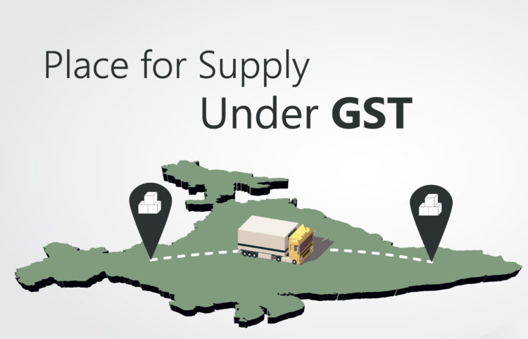
PLACE of Supply
Taxable at the place of provision of service
Eg: Beauty treatment of actors while shooting

Slide 18
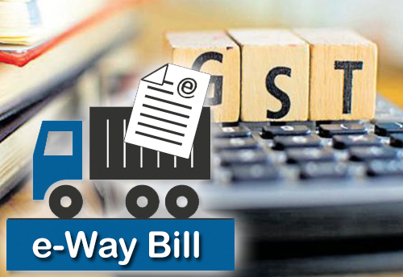
Concept of E-way Bills
By Whom
It is a document uploaded by dealers for consignment above Rs.50,000/-
For What
Supply
Other than Supply
Inward Supply From Unregistered Dealer
Continued…..

Slide 19
It is a document to be generated before the movement of goods/services
The document can be generated via Mobile SMS
A unique EBN is generated for each E-way bill
The E-way Bill is Password protected
The E- Way bill can also be cancelled within 24 hours of uploading.
However once the E-way Bill is verified by the PO it cannot be cancelled
Validity of Bill depends upon distance of travel
<100 Km :1 Day
100 to 300 Km :3 days
300t o500 Km :5 Days
500 to 1000 Km :10 days
>1000 Km :15 days
The Commissioner is empowered with extending the validity of bill in certain cases.
E-way Bill can also be generated for consignment less than Rs.50,000/- at discretion of dealer.

Slide 20
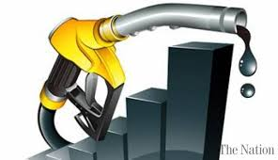
Transactions out of GST
Real Estate Transactions
5 Petroleum Products: Natural Gas, Petrol, Diesel, Crude Oil,& Aviation Fuel.
Alcoholic Liquor for human Consumption
Electricity

Slide 21
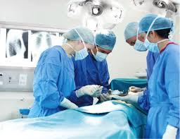
GST Exempted Services
Education Services
Health Care Services
All Collection by educational Institution Exempt
However Service to colleges is taxable but Service to Schools is exempt.

Slide 22
Treatment of Capital Goods
In GST Capital Goods Means All Fixed Assets shown in Balance Sheet & used for furtherance of business.
No Input Credit for Building or Building Construction Material
Interior decoration will not be treated as Building
Thus it is advisable to do Interior decoration after the Appointed date of GST to claim Input Tax Credit
Continued…..

Slide 23
Input Tax Credit can only be claimed by Registered dealer
Unregistered dealer /Composition dealer under existing tax laws migrated to GST cannot claim Input Tax Credit on Capital goods
Advance paid before 01-07-2017 & not delivered until 01-07-2017 – No Input Tax Credit Claim.
No Input Tax Credit on Land
The Input Tax Credit due on Capital Goods can be claimed in the next month as in case of ITC.
No concept of Installments on Input Tax Credit for Capital Goods

Slide 24
Input Tax Credit on Motor Cars
If he is Motor Vehicle Dealer
If he is using Motor Vehicle for transport of Goods /Passengers
Only
On event of sale of Motor Vehicle dealer has to pay GST – Double Taxation

Slide 25
Criteria for claiming Input Tax Credit
Possession of invoices
Goods should be received
Tax should be paid by the dealer
Return should be filed by the dealer
Payments should be made within 180days of supply otherwise tax credit taken has to be reversed

Slide 27
Likely challenges to enforcement agencies
Managing risk of GST fraud
Training needs
Robust GSTN and online compliances
Taxation of services by States
Role of customs authorities
Key challenges
Coordination between state & central departments

Slide 28
Issues to be addressed with new regime
Supply based taxation
Taxability of inter-unit transfers
Job-work / tolling arrangements
Determining consumption state
Determining origin state
Taxing jurisdiction in case of chain transactions
Taxation of imports

Slide 29
“King must collect taxes like honey bee, it should be enough to sustain but not too much to destroy.”
Chanakya………

Slide 30
Dr B Gopakumar
Associate Professor and Head
P.G Department of Commerce
N.S.S College Pandalam

